Slide 1




PRESENTATION
LIVE-STREAM FOR CHURCH SERVICES.

Slide 2



What is live streaming?
Live streaming is the process of broadcasting video and audio content over the internet in real-time. It allows viewers to watch and engage with the content as it happens, without needing to download or wait for a recording. Live streaming can be done on various platforms, including social media sites like YouTube, Facebook, Instagram, and Twitch, as well as specialized streaming services

Slide 3



Key benefits
Real-time interaction, Engagement, etc

Slide 4
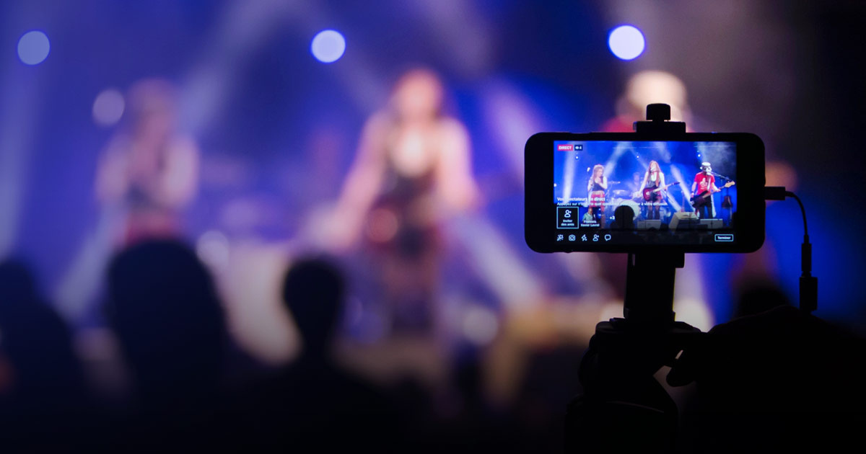
STUDIO SHODWE
Popular Platforms:
YouTube Live, Facebook Live, Twitch, Instagram Live.

Slide 5
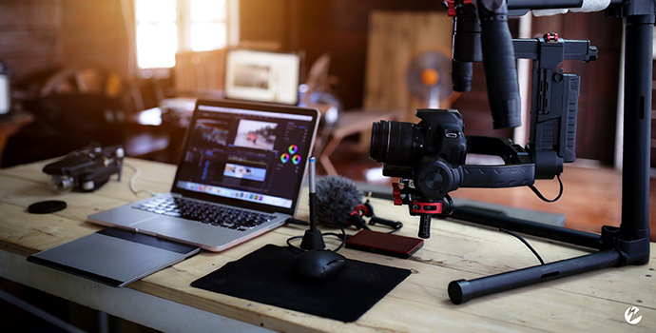
Understand the Equipment

Slide 6
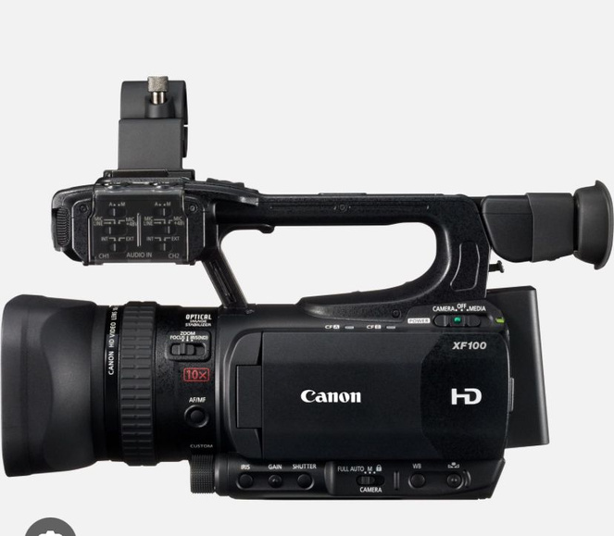
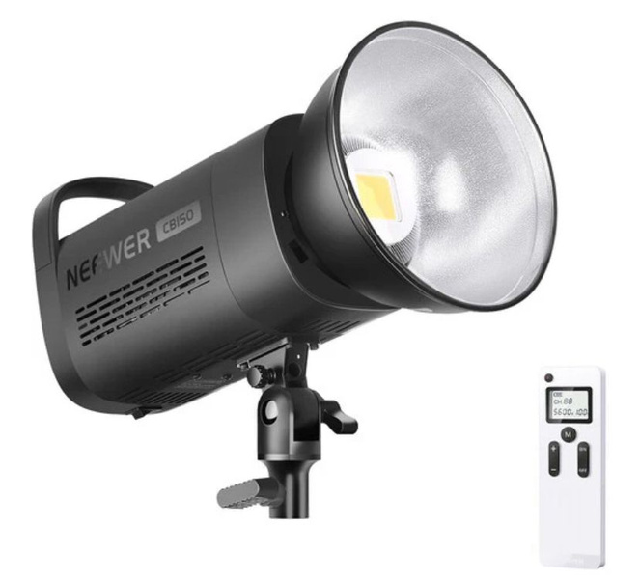
Camera: Start with a good-quality camera or a smartphone with a tripod.
Microphone: Use a dedicated microphone for clear audio (built-in or external).
Lighting: Ensure proper lighting, especially for indoor services.
Streaming Platform: Decide whether you’ll stream on Facebook, YouTube, or a church-specific platform.

Slide 7
Set Up the Streaming Software

Slide 8


Streaming Software: Introduce OBS Studio (Open Broadcaster Software, Vmix) or other platforms like StreamYard.
Configure the Software: Show them how to set up the camera feed, add the microphone, and adjust basic settings (bitrate, resolution).
Test the Setup: Run test streams to ensure everything works well and looks professional.

Slide 9
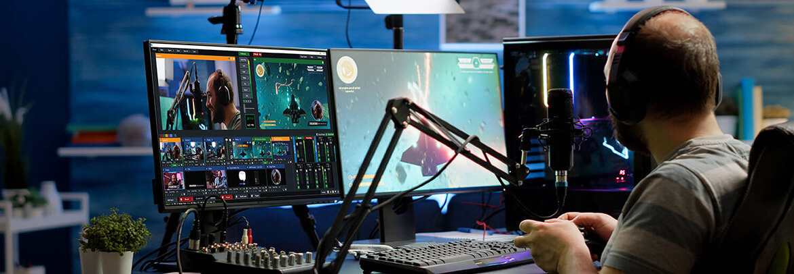
Streaming Platforms

Slide 10
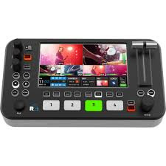
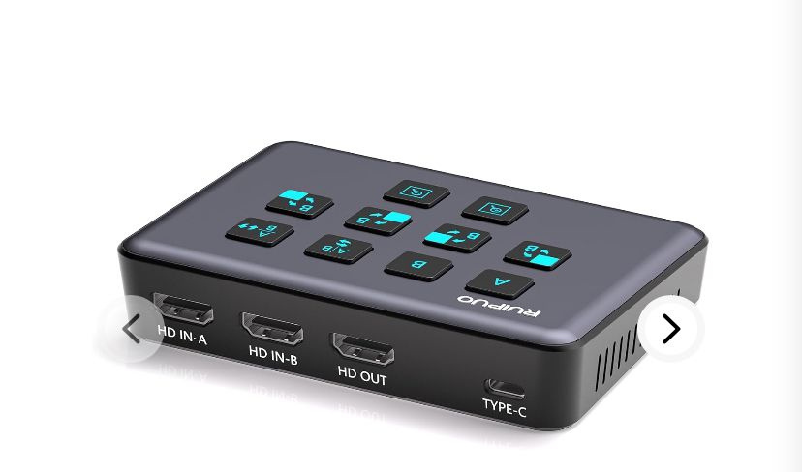
Create Accounts: Create church accounts on platforms like YouTube or Facebook if needed.
Set Up Streaming Links: Teach to schedule streams, create stream keys, and copy those into the software.
Optimize for Live Audiences: Learn to use features like chat moderation, titles, and descriptions to engage viewers.
2022 PRESENTATION

Slide 11
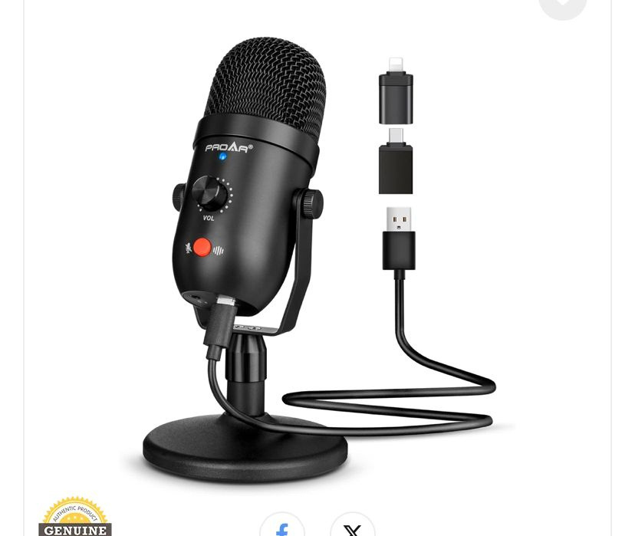
Manage Audio
and Video Quality
2022 PRESENTATION

Slide 12
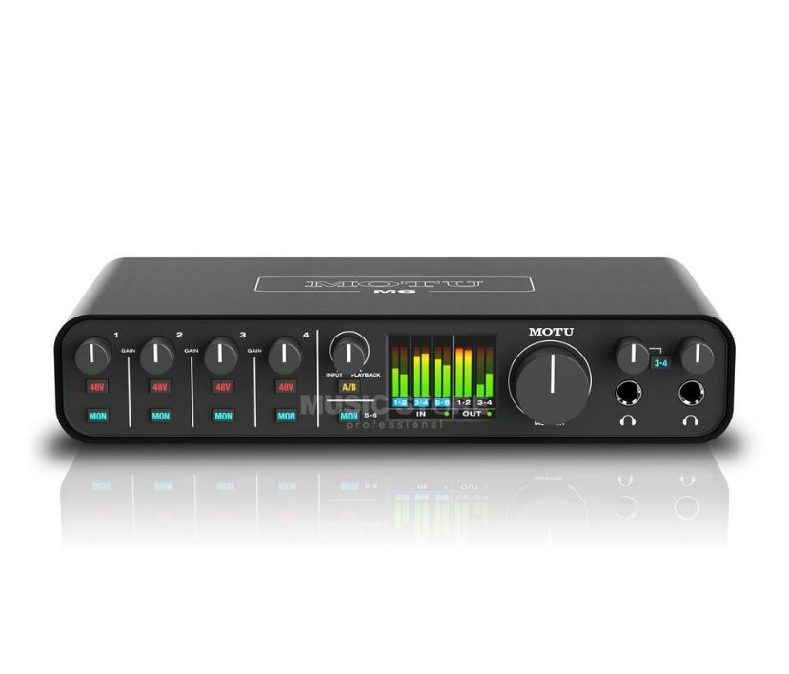
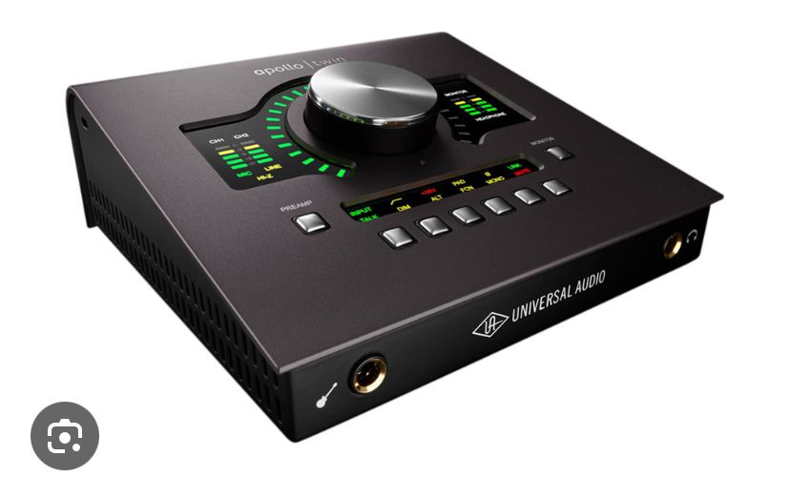
Audio Monitoring: Train on how to monitor audio levels in the software to avoid clipping or background noise.
Multi-Camera Setup: If using multiple cameras, teach switching between camera feeds using software or switchers.

Slide 13
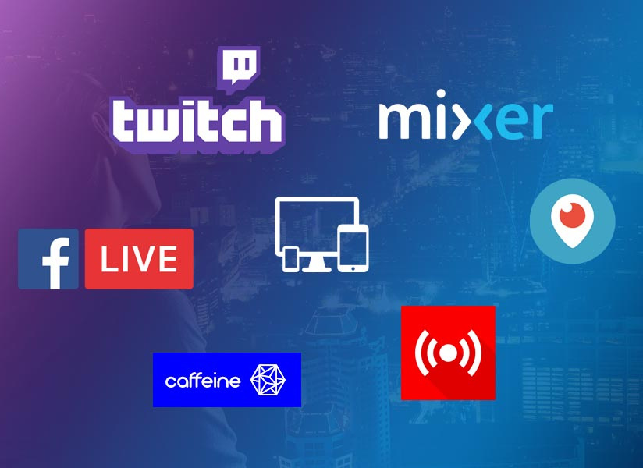
Engage
Viewers

Slide 14
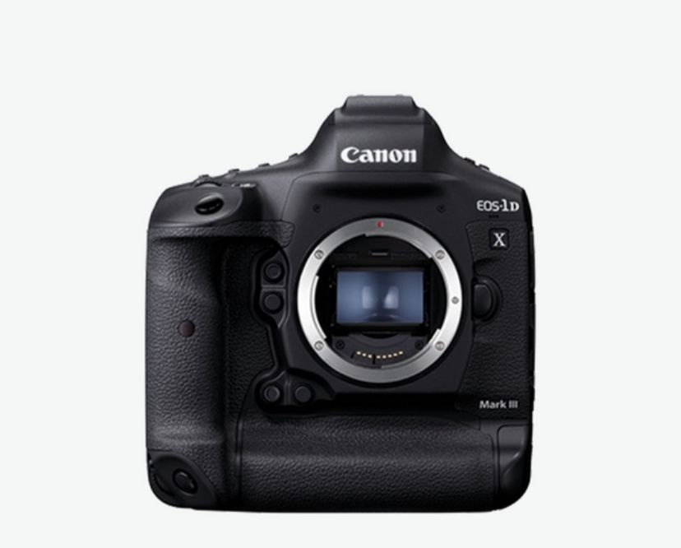
Interactive Elements: Show how to add lyrics, sermon points, and scripture to the stream (using overlays or screen sharing).
Moderation: Teach someone to monitor comments and interact with the audience (respond to prayer requests, etc.).
2022 PRESENTATION

Slide 15
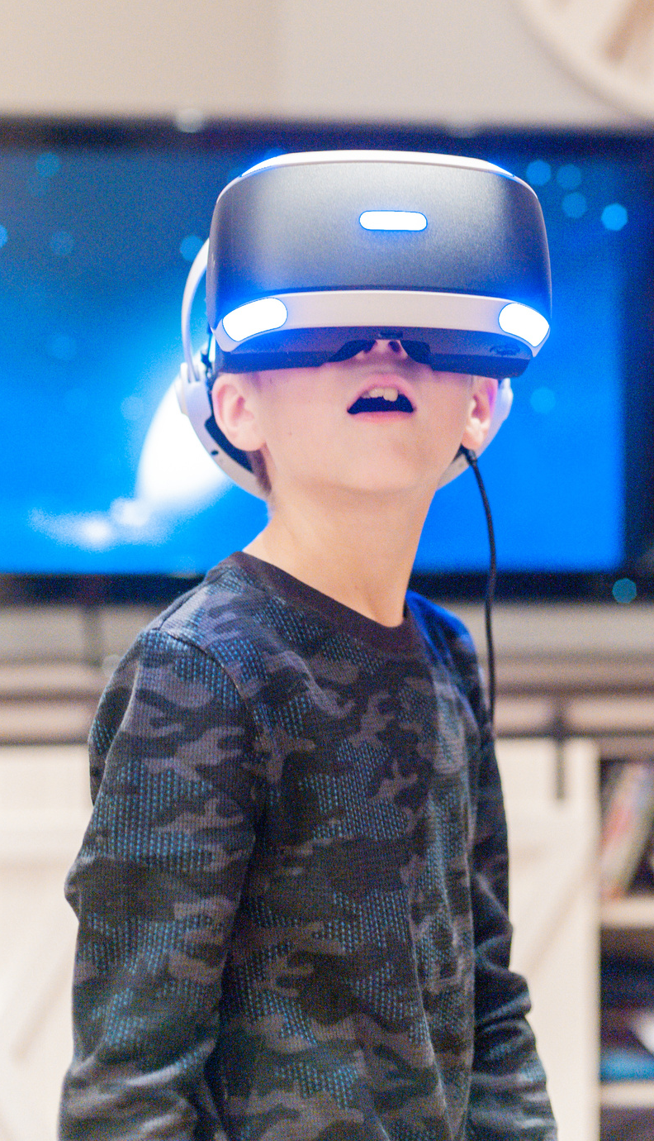
Backup Plan
2022 PRESENTATION

Slide 16
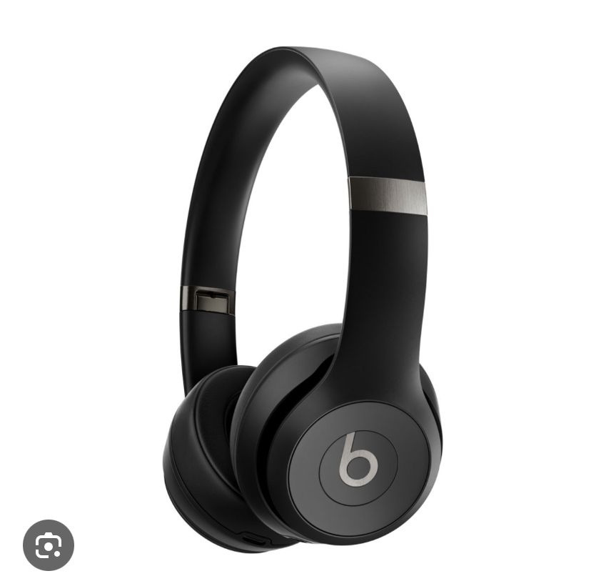
Internet Backup: Have a secondary internet connection or plan in case of connectivity issues.
Recording the Stream: Always record the stream for post-service review and
re-upload if necessary.
2022 PRESENTATION

Slide 17
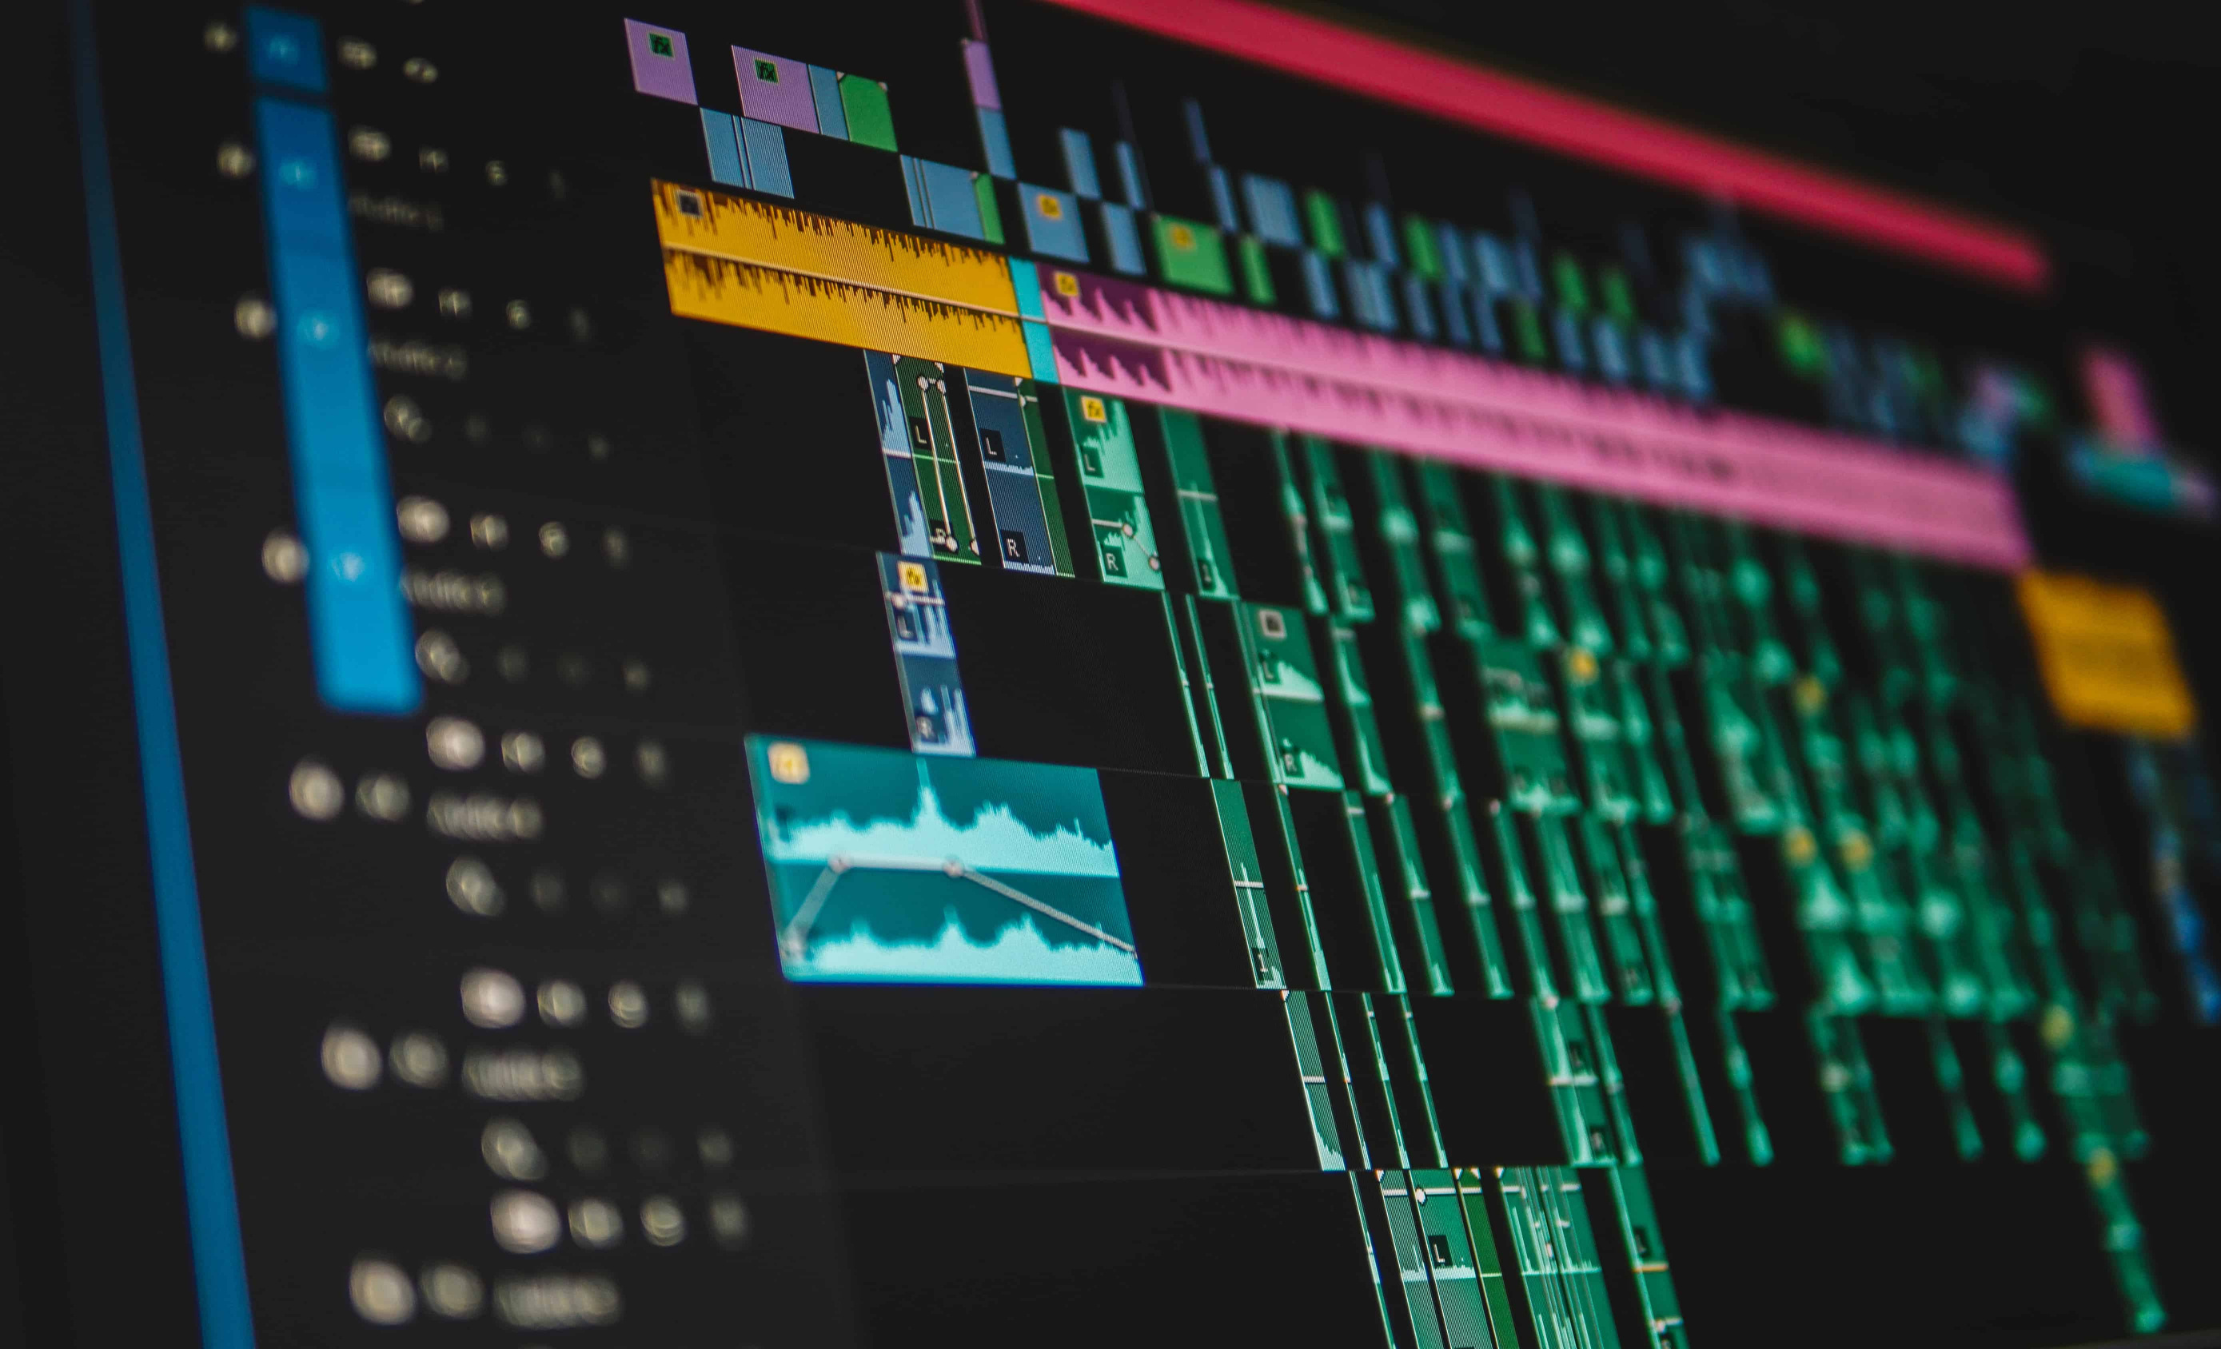
Post-Stream Process
2022 PRESENTATION

Slide 18
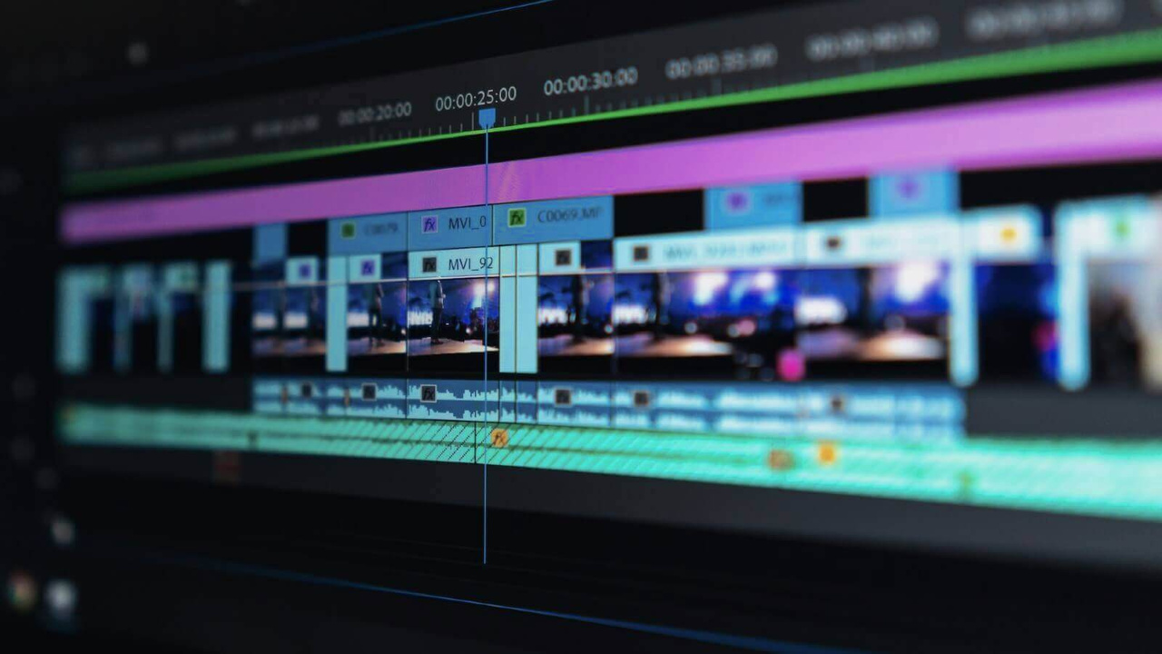
Edit and Archive: Teach basic editing (trim, highlight) for social media. Post the service recording on YouTube or the church website.
Analytics: Review viewer engagement data and use it to improve future streams.

Slide 19
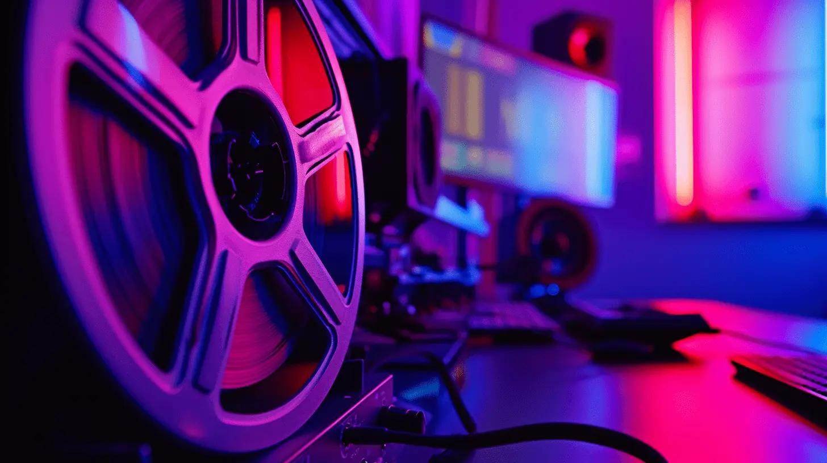
Basic Equipment and Setup
2022 PRESENTATION

Slide 20
1. Camera:
Webcam: A good-quality webcam (e.g., Logitech C920) is an affordable and straightforward option.
Smartphone Camera: Modern smartphones often have excellent cameras for live streaming.
2. Microphone:
Built-in Microphone: Many webcams and smartphones have built-in mics, though their quality may be limited.
USB Microphone: A simple USB microphone (e.g., Blue Yeti, Samson Meteor) provides better audio quality.

Slide 21
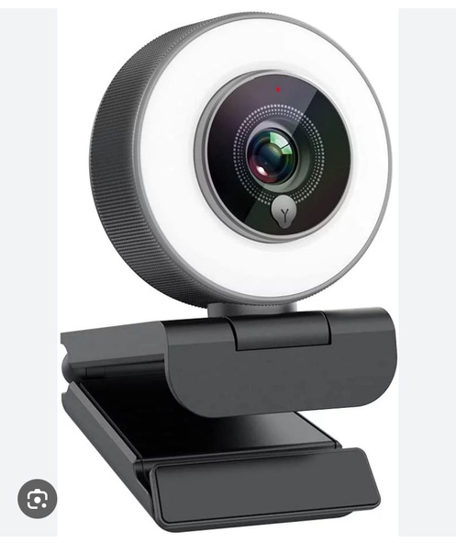
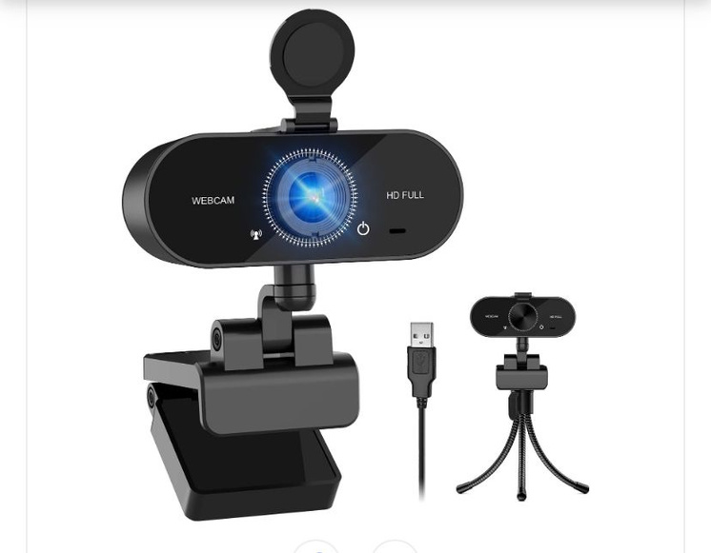
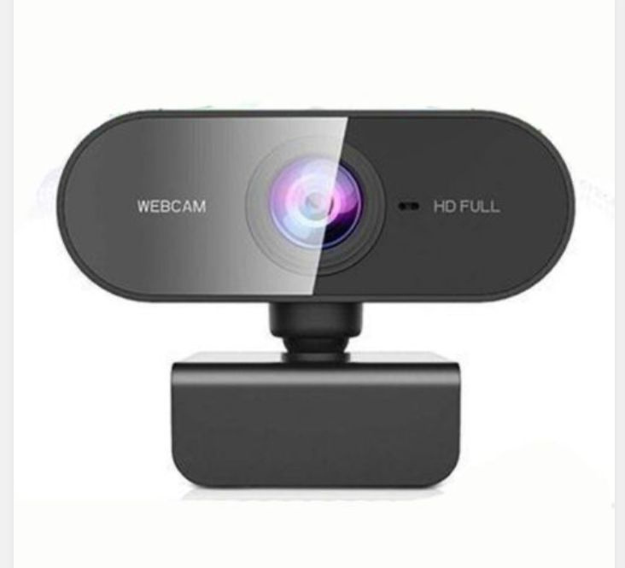
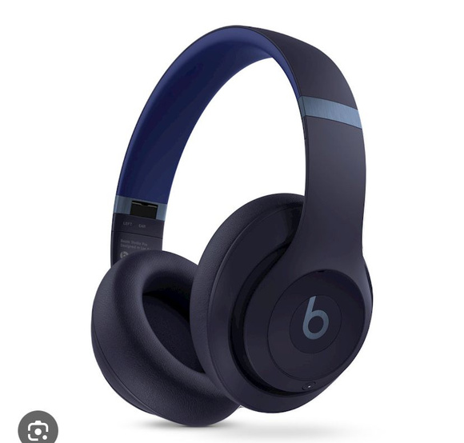
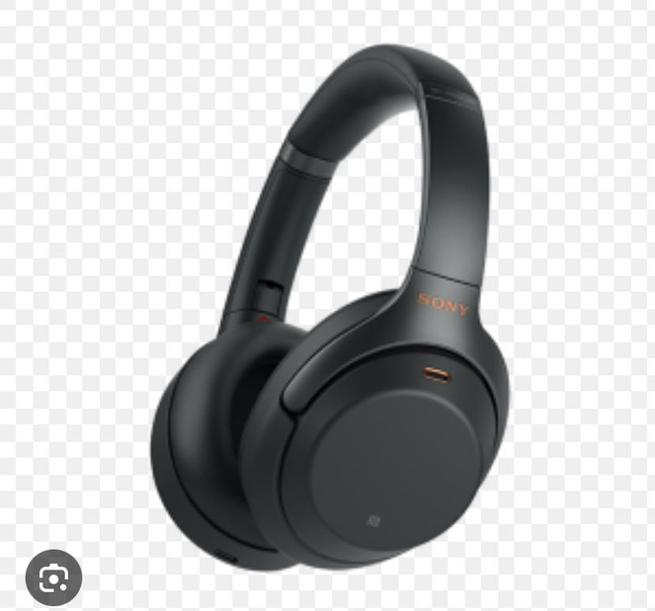

Slide 22
3. Lighting:
Natural Light: Utilize natural light from windows.
Basic Ring Light: Affordable ring lights can help improve lighting quality.
Computer or Mobile Device: A reliable computer or smartphone capable of handling live streaming software and internet demands.
•5. Internet Connection:
• - Broadband Connection: A stable internet connection with at least 5 Mbps upload speed is recommended for basic streaming.

Slide 23

Advanced Equipment and Setup

Slide 24
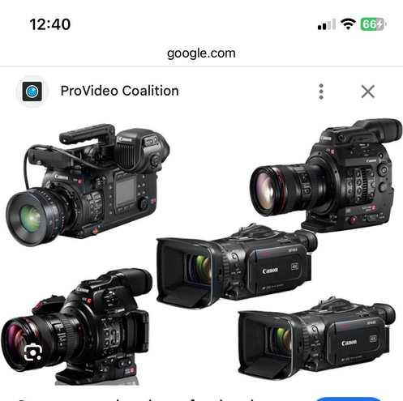
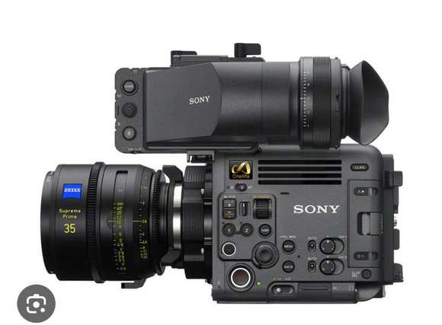
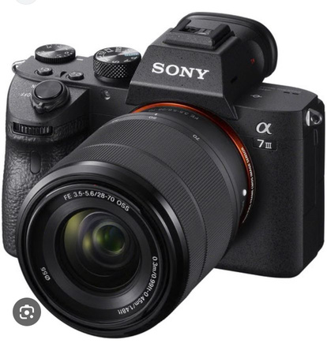
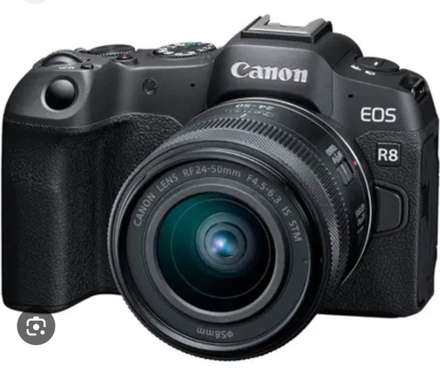
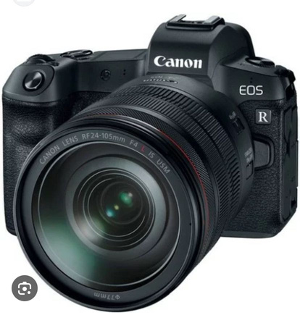
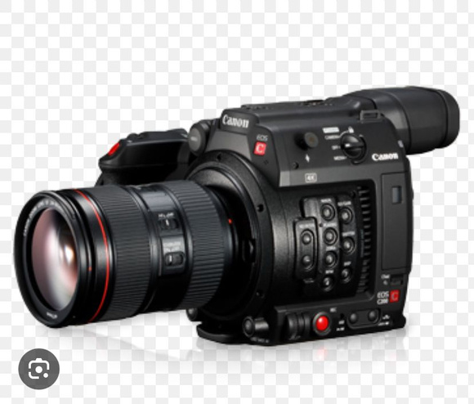
Camera:
DSLR/Mirrorless Camera: For high-quality video (e.g., Canon EOS M50, Sony A6400).

Slide 25
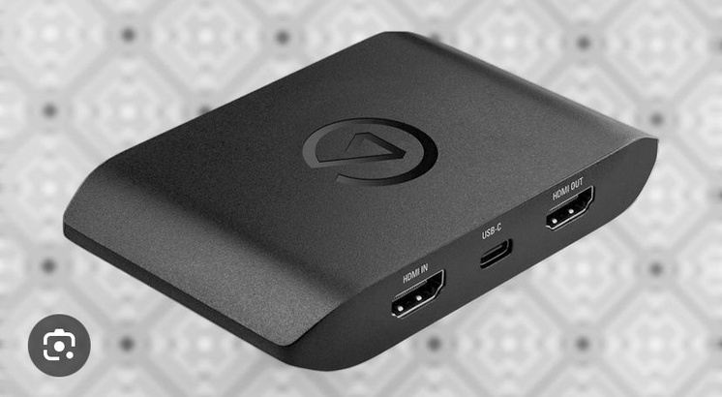
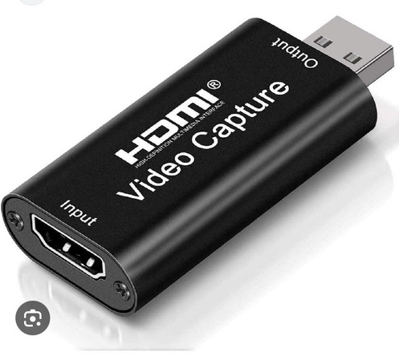
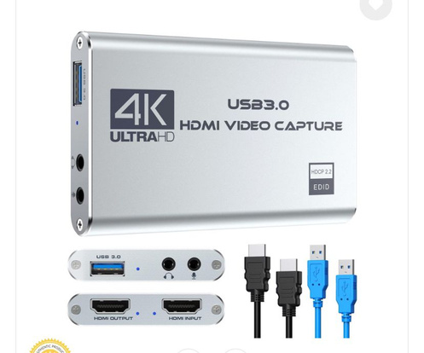
Capture Card: Required for connecting a DSLR or mirrorless camera to a computer (e.g., Elgato Cam Link).

Slide 26
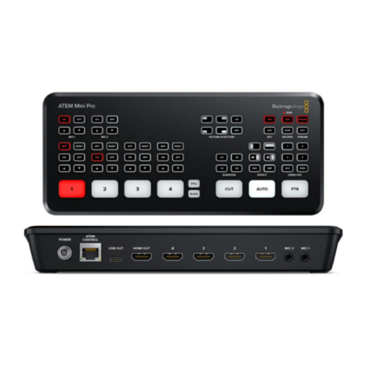
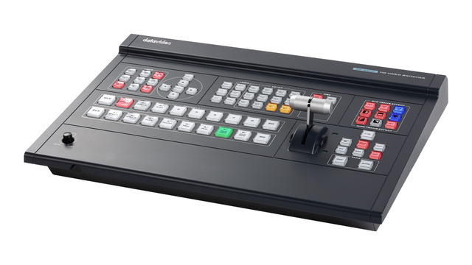
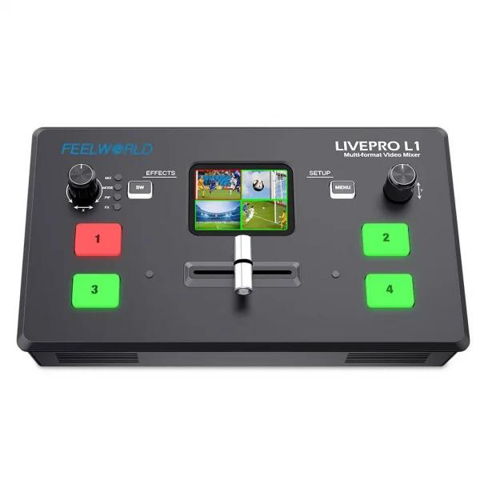
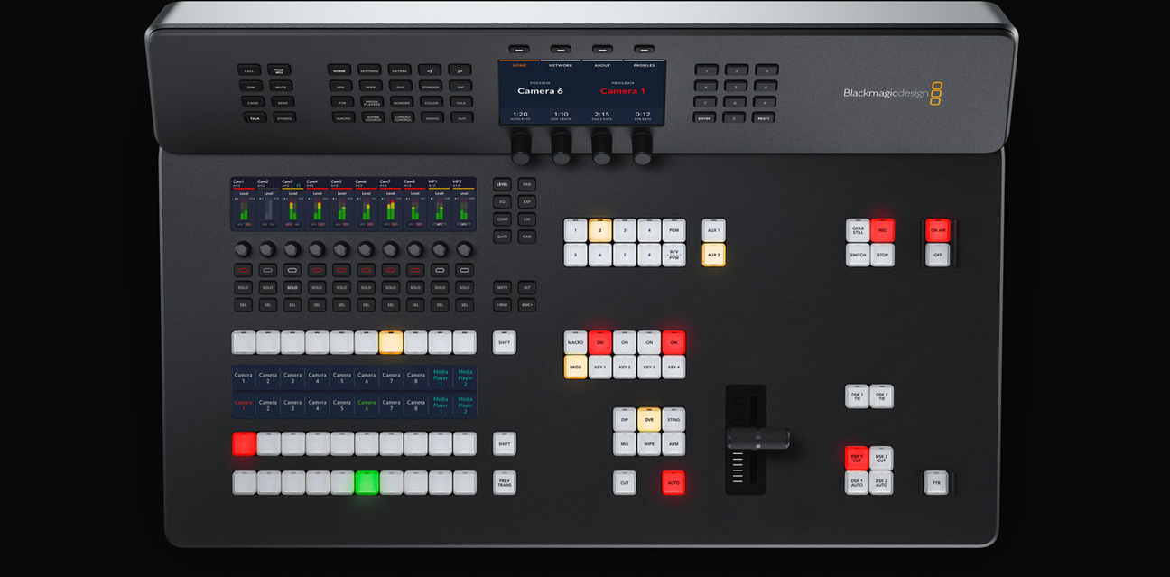
•Mixers, Switchers, and Encoders

Slide 27
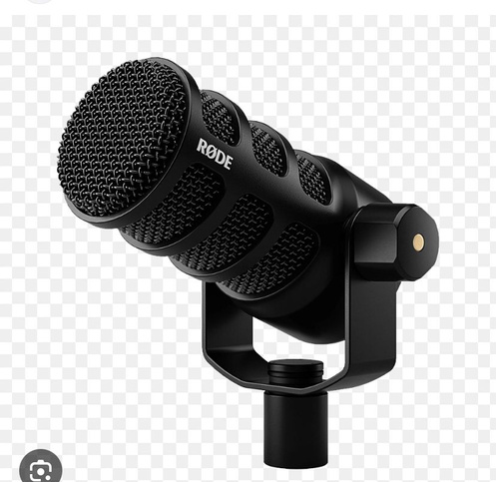
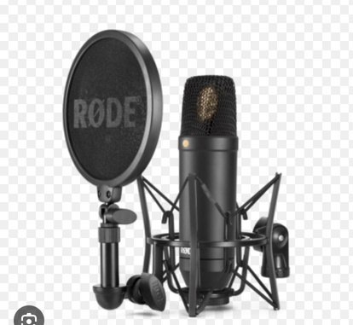
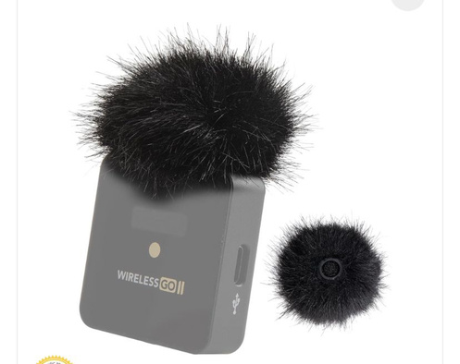
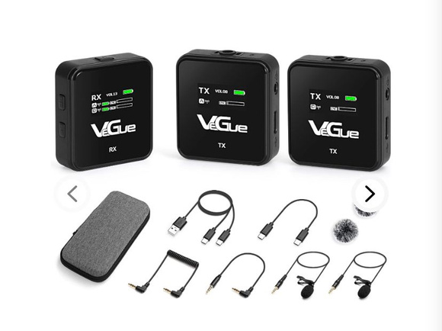
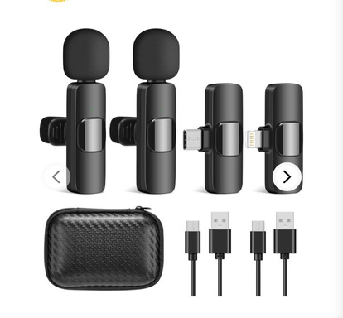
Microphone:
-Condenser Microphone: Provides professional sound quality (e.g., Audio-Technica AT2020).
- **Dynamic Microphone:** Suitable for various environments (e.g., Shure SM7B).
- Lavalier Microphone: Wireless lapel mics for hands-free audio (e.g., Rode Wireless GO).

Slide 28
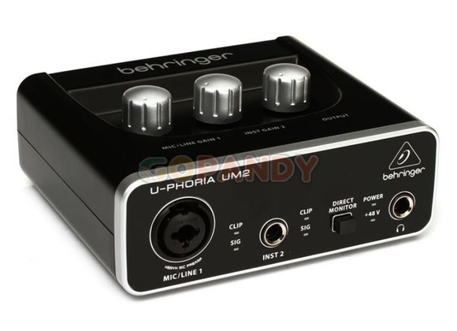
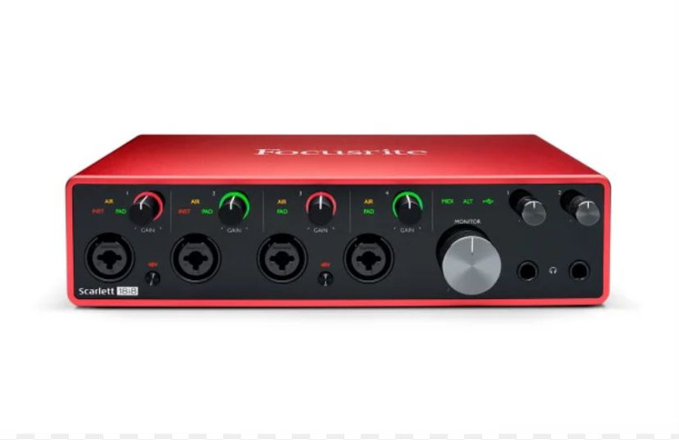
. Audio Interface or Mixer:
Connecting professional microphones and managing audio levels (e.g., Focusrite Scarlett, Behringer Xenyx).

Slide 29
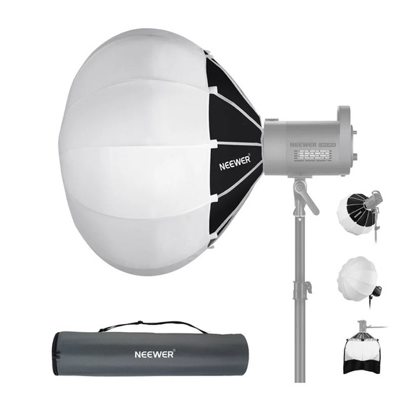
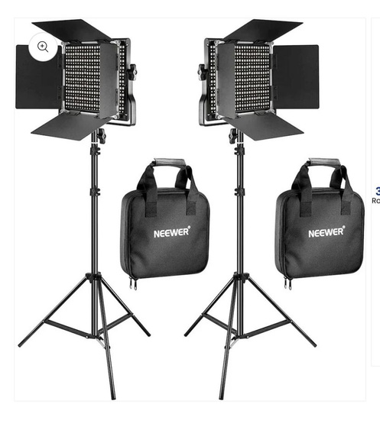
4. Lighting:
Softbox Lights: Provide soft, even lighting.
LED Panels: Adjustable lighting for different settings (e.g., Neewer LED panels).
Three-Point Lighting Setup: Key light, fill light, and backlight for professional lighting.

Slide 30

Streaming Software and Tools:
Advanced Software: OBS Studio (advanced setup), Streamlabs, vMix for more complex streams.

Slide 31




STUDIO SHODWE
Contact
+233246306770
ephraim.ahorlu@gcmghana.org
www.gcmghana.oorg

Slide 32

THANK YOU

